Slide 1
The Greek Letters
Chapter 18
18.<number>

Slide 2
Example
18.<number>
A bank has sold for $300,000 a European call option on 100,000 shares of a nondividend paying stock
S₀ = 49, K = 50, r = 5%, σ = 20%,
T = 20 weeks, μ = 13%
The Black-Scholes value of the option is $240,000
How does the bank hedge its risk to lock in a $60,000 profit?

Slide 3
Naked & Covered Positions
18.<number>
Naked position
Take no action
Covered position
Buy 100,000 shares today
Both strategies leave the bank exposed to significant risk

Slide 4
Stop-Loss Strategy
18.<number>
This involves:
Buying 100,000 shares as soon as price reaches $50
Selling 100,000 shares as soon as price falls below $50
This deceptively simple hedging strategy does not work well

Slide 5
Delta (See Figure 17.2, page 361)
18.<number>
Delta (Δ) is the rate of change of the option price with respect to the underlying
Option
price
Slope = Δ
B
A
Stock price

Slide 6
Delta Hedging
18.<number>
This involves maintaining a delta neutral portfolio
The delta of a European call on a stock paying dividends at rate q is N (d ₁)e^{– qT}
The delta of a European put is
e^{– qT} [N (d ₁) – 1]

Slide 7
Delta Hedging continued
18.<number>
The hedge position must be frequently rebalanced
Delta hedging a written option involves a “buy high, sell low” trading rule
See Tables 17.2 (page 364) and 17.3 (page 365) for examples of delta hedging

Slide 8
Using Futures for Delta Hedging
18.<number>
The delta of a futures contract is e^{(r-q)T} times the delta of a spot contract
The position required in futures for delta hedging is therefore e^{-(r-q)T} times the position required in the corresponding spot contract

Slide 9
Theta
18.<number>
Theta (Θ) of a derivative (or portfolio of derivatives) is the rate of change of the value with respect to the passage of time
See Figure 17.5 for the variation of Θ with respect to the stock price for a European call

Slide 10
Gamma
18.<number>
Gamma (Γ) is the rate of change of delta (Δ) with respect to the price of the underlying asset
See Figure 17.9 for the variation of Γ with respect to the stock price for a call or put option

Slide 11
Gamma Addresses Delta Hedging Errors Caused By Curvature
(Figure 17.7, page 369)
18.<number>
Call
price
C’’
C’
C
Stock price
S
S’

Slide 12
Interpretation of Gamma
18.<number>
For a delta neutral portfolio,
δΠ ≈ Θ δt + ½ΓδS ²
δΠ
δΠ
δS
δS
Positive Gamma
Negative Gamma

Slide 13
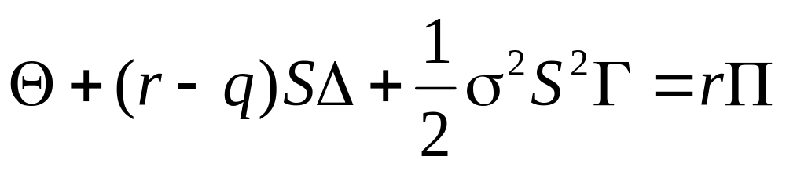
Relationship Among Delta, Gamma, and Theta
18.<number>
For a portfolio of derivatives on a stock paying a continuous dividend yield at rate q

Slide 14
Vega
18.<number>
Vega (ν) is the rate of change of the value of a derivatives portfolio with respect to volatility
See Figure 17.11 for the variation of ν with respect to the stock price for a call or put option

Slide 15
Managing Delta, Gamma, & Vega
18.<number>
Δ can be changed by taking a position in the underlying
To adjust Γ & ν it is necessary to take a position in an option or other derivative

Slide 16
Rho
18.<number>
Rho is the rate of change of the value of a derivative with respect to the interest rate
For currency options there are 2 rhos

Slide 17
Hedging in Practice
18.<number>
Traders usually ensure that their portfolios are delta-neutral at least once a day
Whenever the opportunity arises, they improve gamma and vega
As portfolio becomes larger hedging becomes less expensive

Slide 18
Scenario Analysis
18.<number>
A scenario analysis involves testing the effect on the value of a portfolio of different assumptions concerning asset prices and their volatilities

Slide 19
Hedging vs Creation of an Option Synthetically
18.<number>
When we are hedging we take positions that offset Δ, Γ, ν, etc.
When we create an option synthetically we take positions that match Δ, Γ, & ν

Slide 20
Portfolio Insurance
18.<number>
In October of 1987 many portfolio managers attempted to create a put option on a portfolio synthetically
This involves initially selling enough of the portfolio (or of index futures) to match the Δ of the put option

Slide 21
Portfolio Insurance continued
18.<number>
As the value of the portfolio increases, the Δ of the put becomes less negative and some of the original portfolio is repurchased
As the value of the portfolio decreases, the Δ of the put becomes more negative and more of the portfolio must be sold

Slide 22
Portfolio Insurance continued
18.<number>
The strategy did not work well on October 19, 1987...

